Slide 1
Gravity Battery
Reynald Aouad
Lynn Aizarani
Tarek Chammas
Charbel Beaini

Slide 2
Table of contents
01
02
03
Introduction
What is a gravity battery and how does it work ?
CAD Design
Matlab
Implementing this concept on Matlab

Slide 3
01
Introduction

Slide 4

AIM
Be innovative
Use material seen in class and implement it in real life solutions
Merge different technologies to have a desired output

Slide 5
Renewable Energy
Not so eco-friendly !

Slide 6

THE PROBLEM
Excess of electricity is WASTED
Storage of energy
Intermittent power
sources

Slide 7
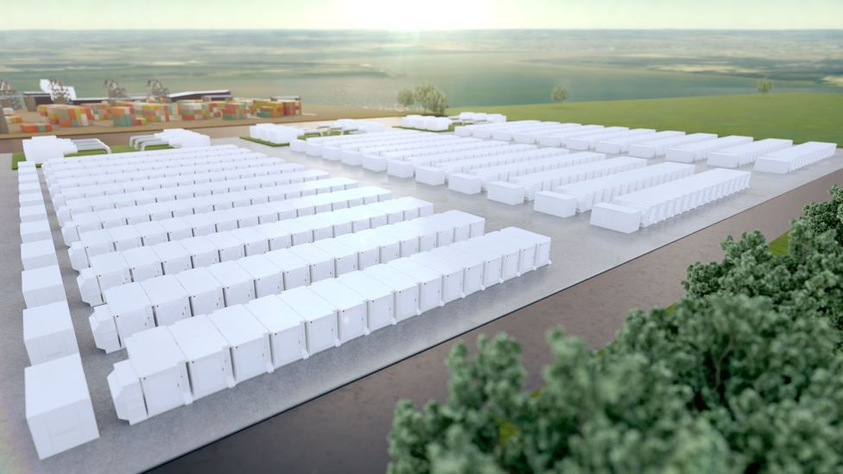
Lithium Ion Batteries
Lithium extraction inevitably harms the soil and causes air contamination
Limited resource
Fire Risk
5-10 years battery life
Cost of storing 1MW is 367$

Slide 8
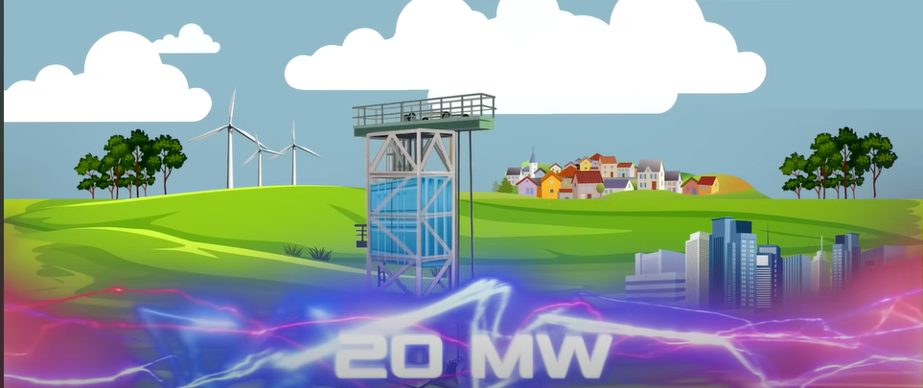
Gravity Battery
No space as we can use abandoned mines
50 years service life with some maintenance
Cost of storing 1MW is 171$
Ecofriendly
Notes:
Which solves the major problems of lithium ion batteries

Slide 9

02
CAD Design

Slide 10
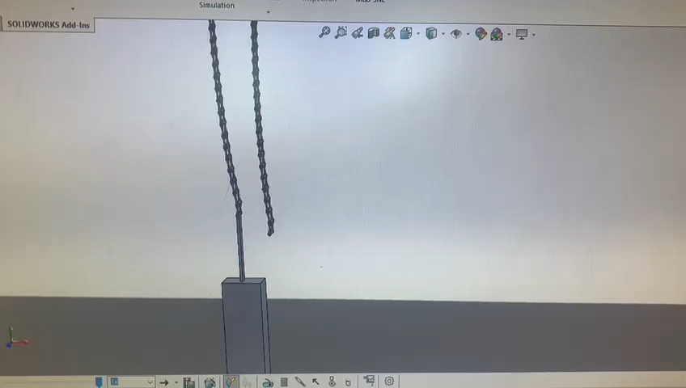
Belt system design
Charging

Slide 11
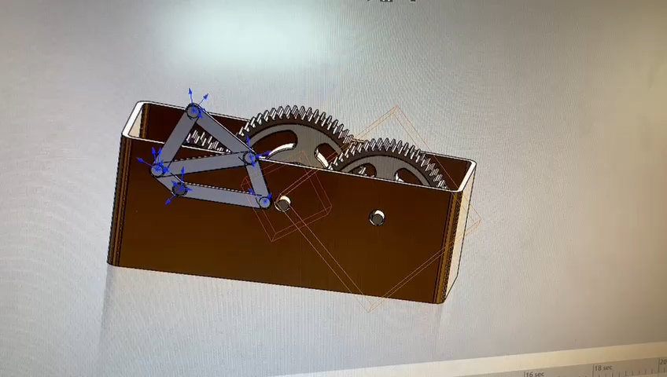
Our chosen output
Gearbox connected to 4 bar mechanism

Slide 12

03
Matlab Design

Slide 13
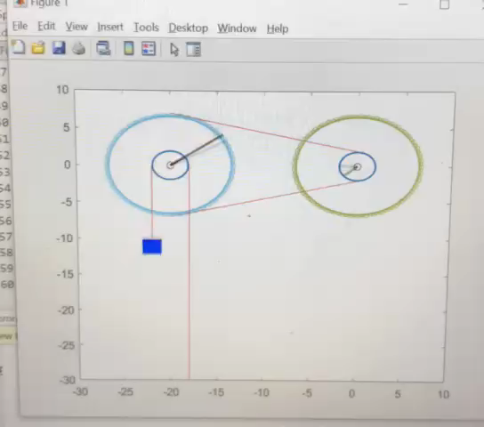
Belt system with weight
Notes:
No input variables since it is our design

Slide 14
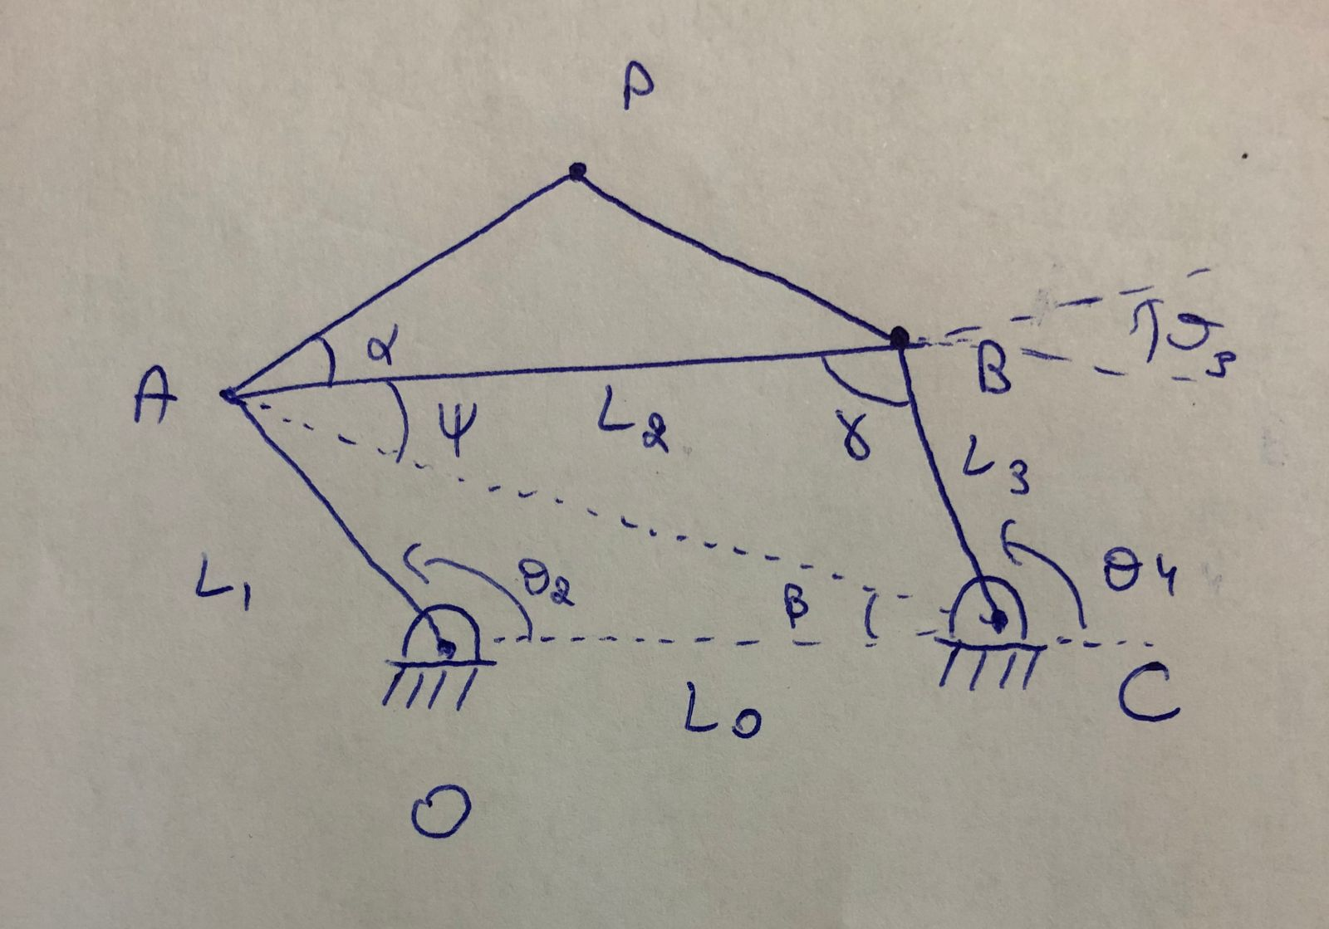
Output as 4 bar mechanism

Slide 15
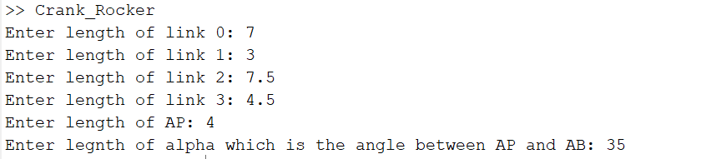
Output as 4 bar mechanism

Slide 16
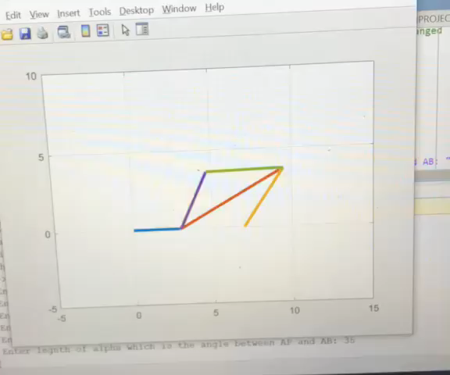
Output as a 4 bar mechanism

Slide 17
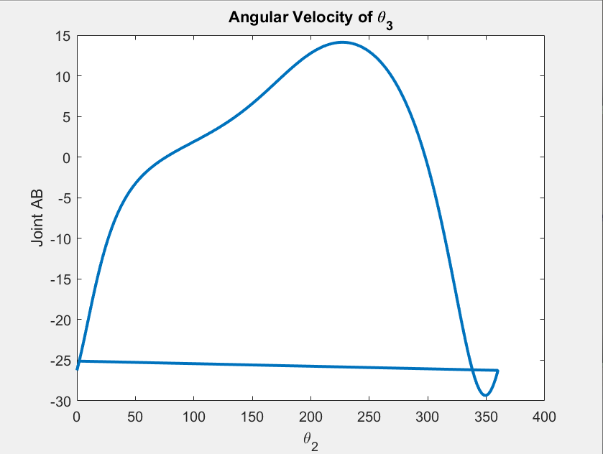
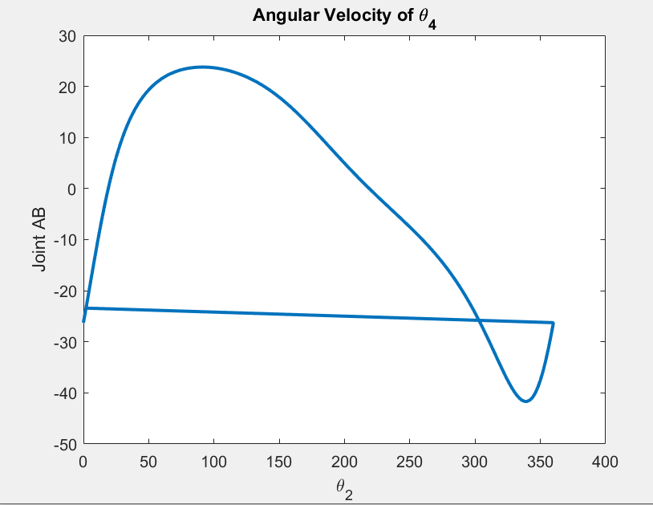
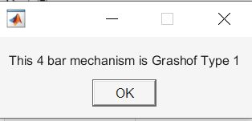
Output as a 4 bar mechanism

Slide 18
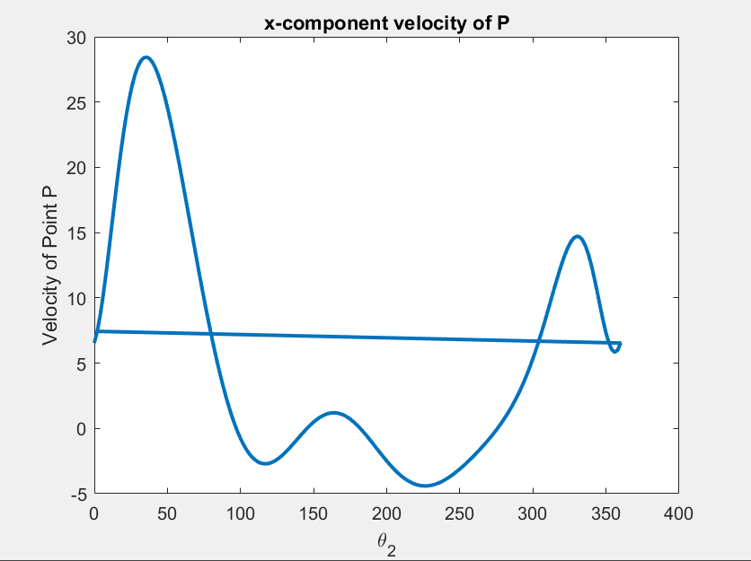
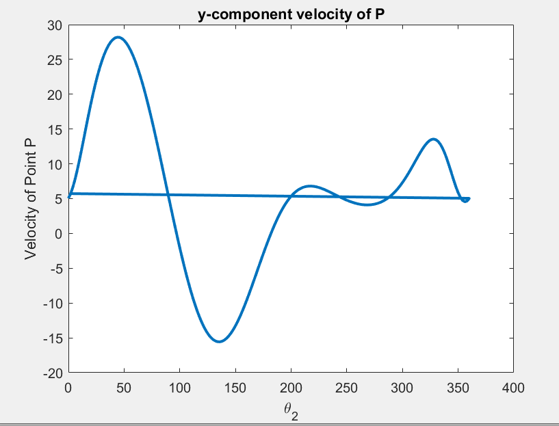
Output as a 4 bar mechanism

Slide 19
Surprise !
Let’s go outside

